Slide 1


NEXT GEN EMPLOYABILITY PROGRAM
CREATING A FUTURE-READY WORKFORCE
Student Name :
Akash Aryan
Student ID :
College Name :
STU644f6dd568d2a1682927061
Sagar Institute of Research and Technology

Slide 2
CAPSTONE PROJECT SHOWCASE
Project Title
Crowdfunding Platform with React and ExpressJS Framework
Abstract | Problem Statement | Project Overview | Proposed Solution | Technology Used | Modelling & Results | Conclusion | Q&A

Slide 3
Abstract
1
Our crowdfunding platform enhances trust and user engagement with secure payments, seamless navigation, and effective communication, ensuring a smooth fundraising experience.
2
Addressing trust, UX, and security issues, our MERN-based platform offers simplified interactions, secure Paytm payments, and real-time updates for a reliable crowdfunding ecosystem.
3
Built on the MERN stack with blockchain integration and Paytm payments, our platform ensures scalability, transparency, and seamless user experience for fundraisers and backers.
4
With profile verification, real-time tracking, and AI-driven recommendations, our platform fosters a secure, engaging, and community-driven crowdfunding experience.

Slide 4


Problem Statement
The crowdfunding platform faces multiple challenges that hinder its effectiveness and user satisfaction, including a complex user experience that leads to high dropout rates, a lack of trust and credibility among backers due to concerns about project legitimacy, insufficient communication channels between creators and supporters, and inadequate security measures for payment processing.

Slide 5

Project Overview
Traditional crowdfunding platforms face issues like trust deficits, security risks, and complex user experiences, leading to high dropout rates. Our project addresses these challenges by building a secure, transparent, and user-friendly crowdfunding platform using the MERN stack and blockchain technology.
We enhance trust and security with secure authentication, encrypted transactions, and Paytm-based payments. The platform enables real-time campaign tracking and seamless communication between donors and creators, ensuring transparency and engagement. A simple UI makes campaign creation and support effortless while minimizing fraud risks.
Future enhancements include AI-powered campaign recommendations, smart contract payments, and a mobile app for broader accessibility. Our goal is to redefine crowdfunding by making it safer, more efficient, and community-driven.

Slide 6
Proposed Solution
Our platform solves key crowdfunding challenges by ensuring security, transparency, and ease of use through MERN stack and blockchain technology. It simplifies fundraising while enhancing trust and engagement.
Secure transactions are enabled through Paytm payment integration, ensuring encrypted and fraud-free financial exchanges. User authentication and verification build trust, while real-time campaign tracking keeps donors informed about fund utilization.
A simple and intuitive UI enhances accessibility, reducing complexity for both fundraisers and donors. Direct communication, AI-driven campaign recommendations, and fraud detection further improve user experience. Future upgrades include smart contract payments and mobile app integration for wider reach.
This solution creates a reliable and efficient crowdfunding ecosystem, making fundraising secure, transparent, and accessible for all.

Slide 7
Technology used
Our crowdfunding platform is built using modern and scalable technologies to ensure security, efficiency, and a seamless user experience.
MERN Stack (MongoDB, Express.js, React.js, Node.js) – Provides a robust, full-stack JavaScript framework for smooth frontend and backend integration.
Blockchain Technology – Enhances transparency and security by enabling tamper-proof transactions and decentralized validation.
Paytm Payment Gateway – Ensures secure, encrypted, and seamless transactions for donors and fundraisers.
AI-Powered Recommendations – Helps users discover relevant campaigns through intelligent suggestions.
JWT Authentication – Provides secure user login and data protection.
Cloud Hosting (Vercel) – Ensures scalability and accessibility with reliable cloud deployment.

Slide 8
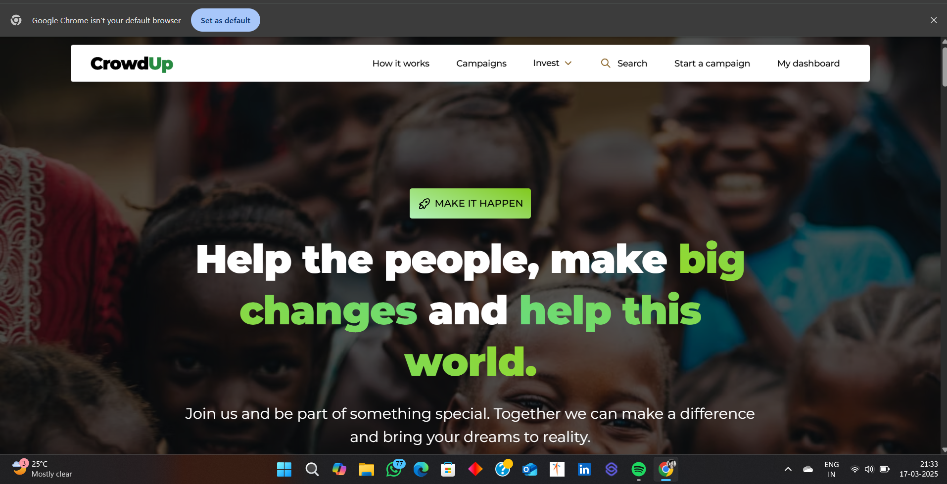
Modelling & Result

Slide 9
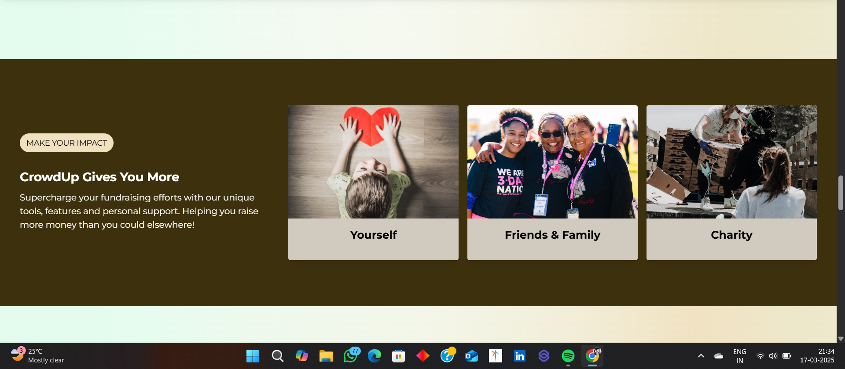
Modelling & Result

Slide 10
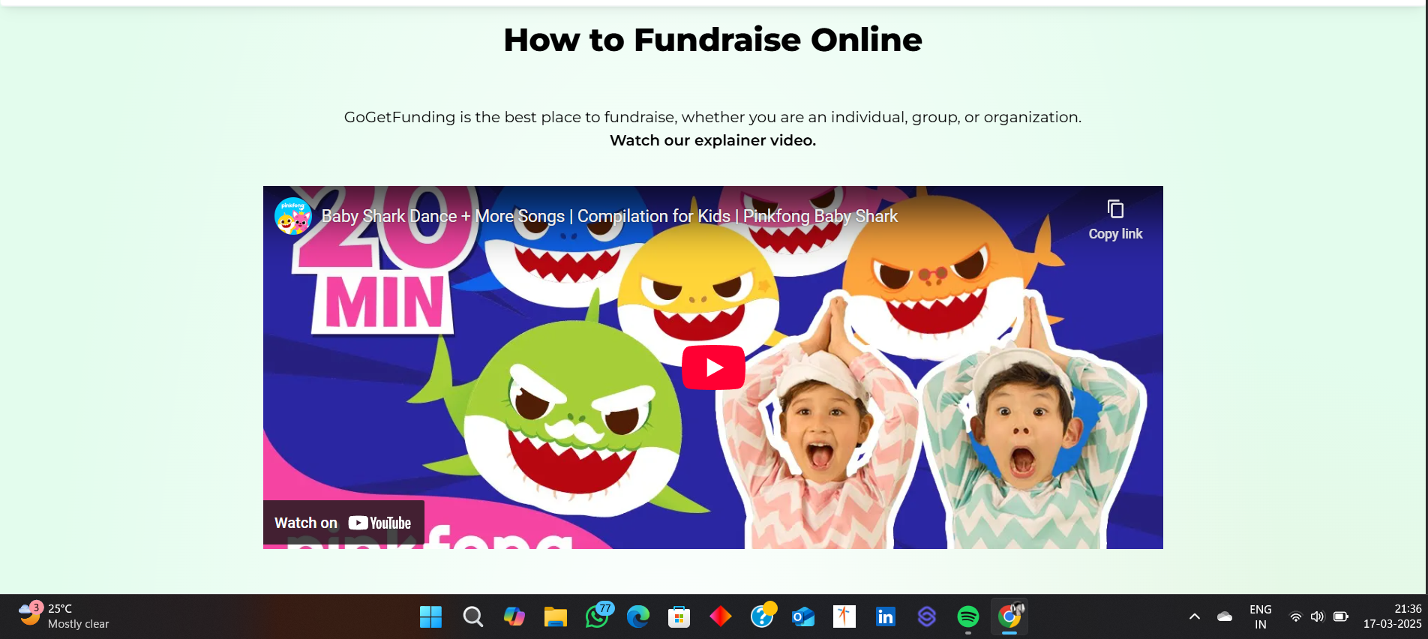
Modelling & Result

Slide 11

Conclusion
Our crowdfunding platform provides a secure, transparent, and user-friendly solution to the challenges faced by traditional fundraising platforms. By integrating secure payment processing, real-time campaign tracking, and AI-powered recommendations, we ensure a seamless experience for both fundraisers and donors.
Looking ahead, we plan to introduce smart contract-based transactions, automated fraud detection, and a mobile-friendly version to expand accessibility and efficiency.
By continuously evolving with technological advancements, this platform aims to redefine crowdfunding and create a more inclusive, reliable, and impactful fundraising ecosystem.

Slide 12


Notes:
Thank You !!

